Slide 1





Linked In Nick Touati Careers Consultant Science & Engineering Faculty Careers Team

Slide 2


Notes:
2 new members per second.
500 Million + users
There are more 40 million students and recent graduates on LinkedIn. They are LinkedIn's fastest-growing demographic.
Q. If there are 40 million students on there, who else will be on there? RECRUITERS!
Your unique Professional story – helps you connect with opportunities
Social Media outputs – different roles to play.
Instagram eg. Really rubbish if you don’t follow and interact with people or things you like. The same applies with LinkedIn

Slide 3
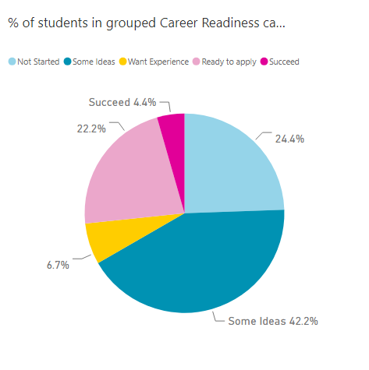
Career Readiness data- first year Mathematics

Slide 4
The essentials
Profile
Network
Engaging on Linked In

Slide 5

Let’s look at the profile!
The CV that never sleeps!

Slide 6
The profile
Photo
Headline
Summary
Experience
Education
Skills
Recommendations
Additional

Slide 7





The Photo- Why they don’t work
Mr Moody – no amateur model poses
Person too small
Very casual
Which person is it? Just one person in shot
Hidden behind dark glasses and a holiday shot

Slide 8
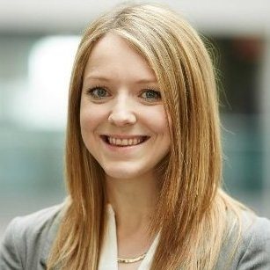
The photo- good headshot

Slide 9
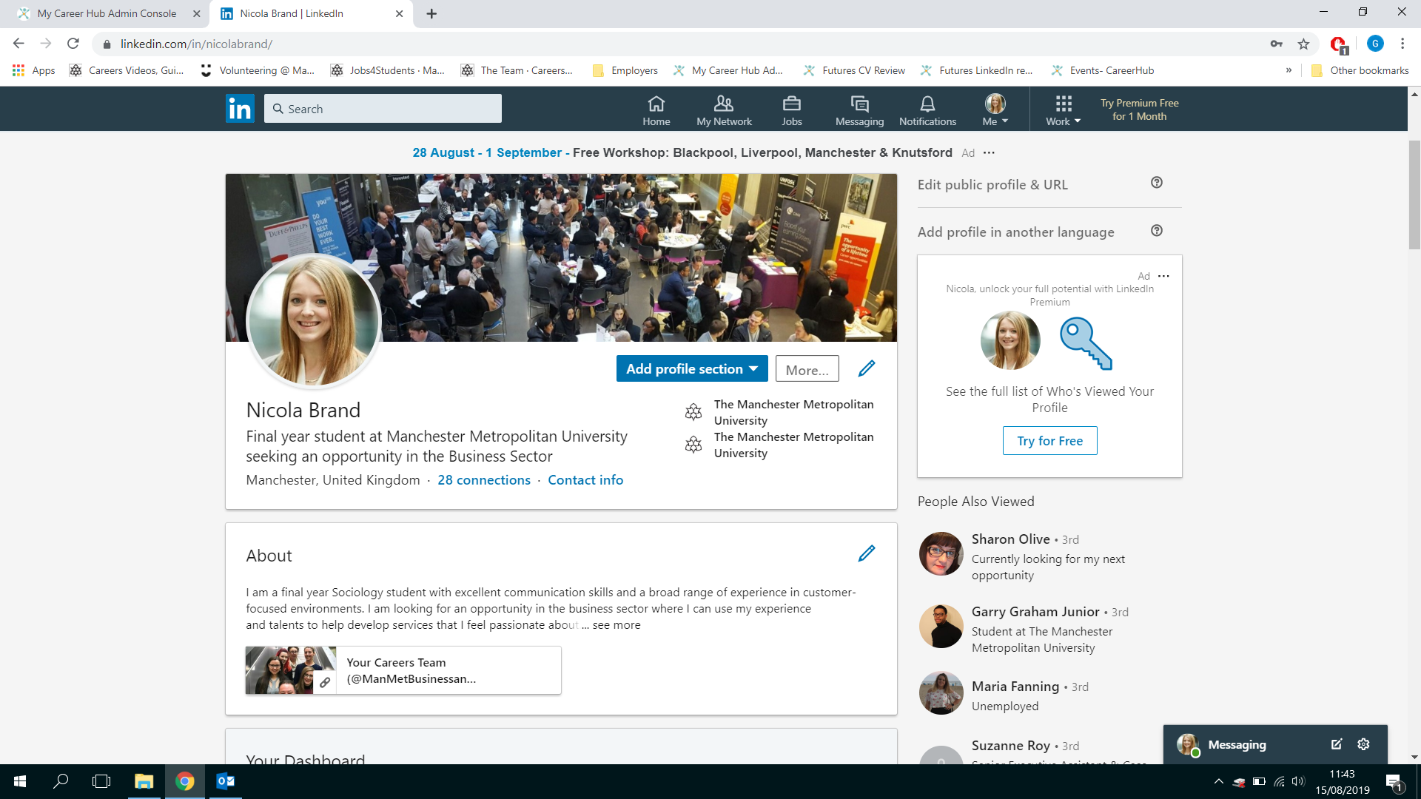

Slide 10
The summary
What have you accomplished?
What are your strengths?
What do you offer to an employer?
Always be positive

Slide 11
What does a good profile look like?
A first year Mathematics student who has developed strong numerical skills and the ability to analyse, interpret and examine data from university study. Work experience in accountancy and job roles within the retail and hospitality sectors have developed commercial awareness and business acumen, together with strong customer service and teamworking skills. Now seeking a role in Business Intelligence and Strategy, with a focus on data visualisation and extraction.

Slide 12
What does a good profile look like?
A first year Mathematics student who has developed strong numerical skills and the ability to analyse, interpret and examine data from university study. Work experience in accountancy and job roles within the retail and hospitality sectors have developed commercial awareness and business acumen, together with strong customer service and teamworking skills. Now seeking a role in Business Intelligence and Strategy, with a focus on data visualisation and extraction.

Slide 13

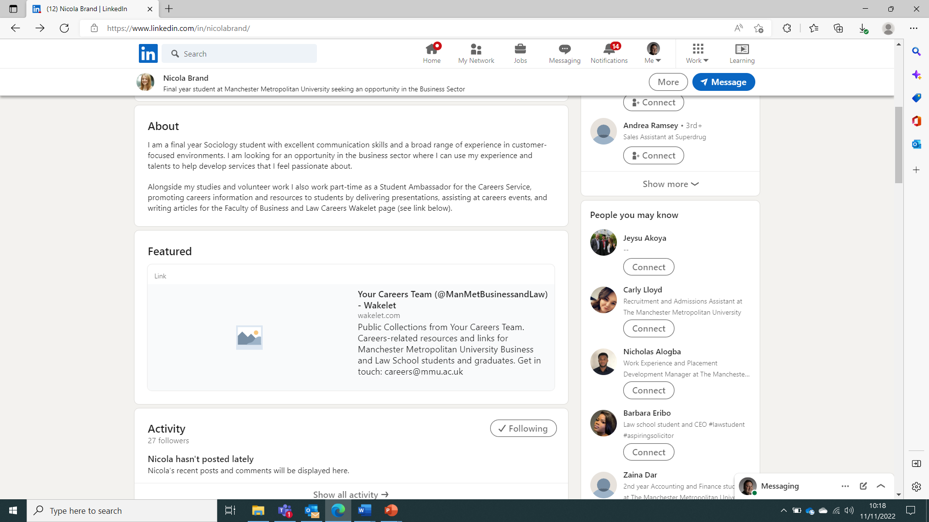
Add slide title here
Add text here

Slide 14
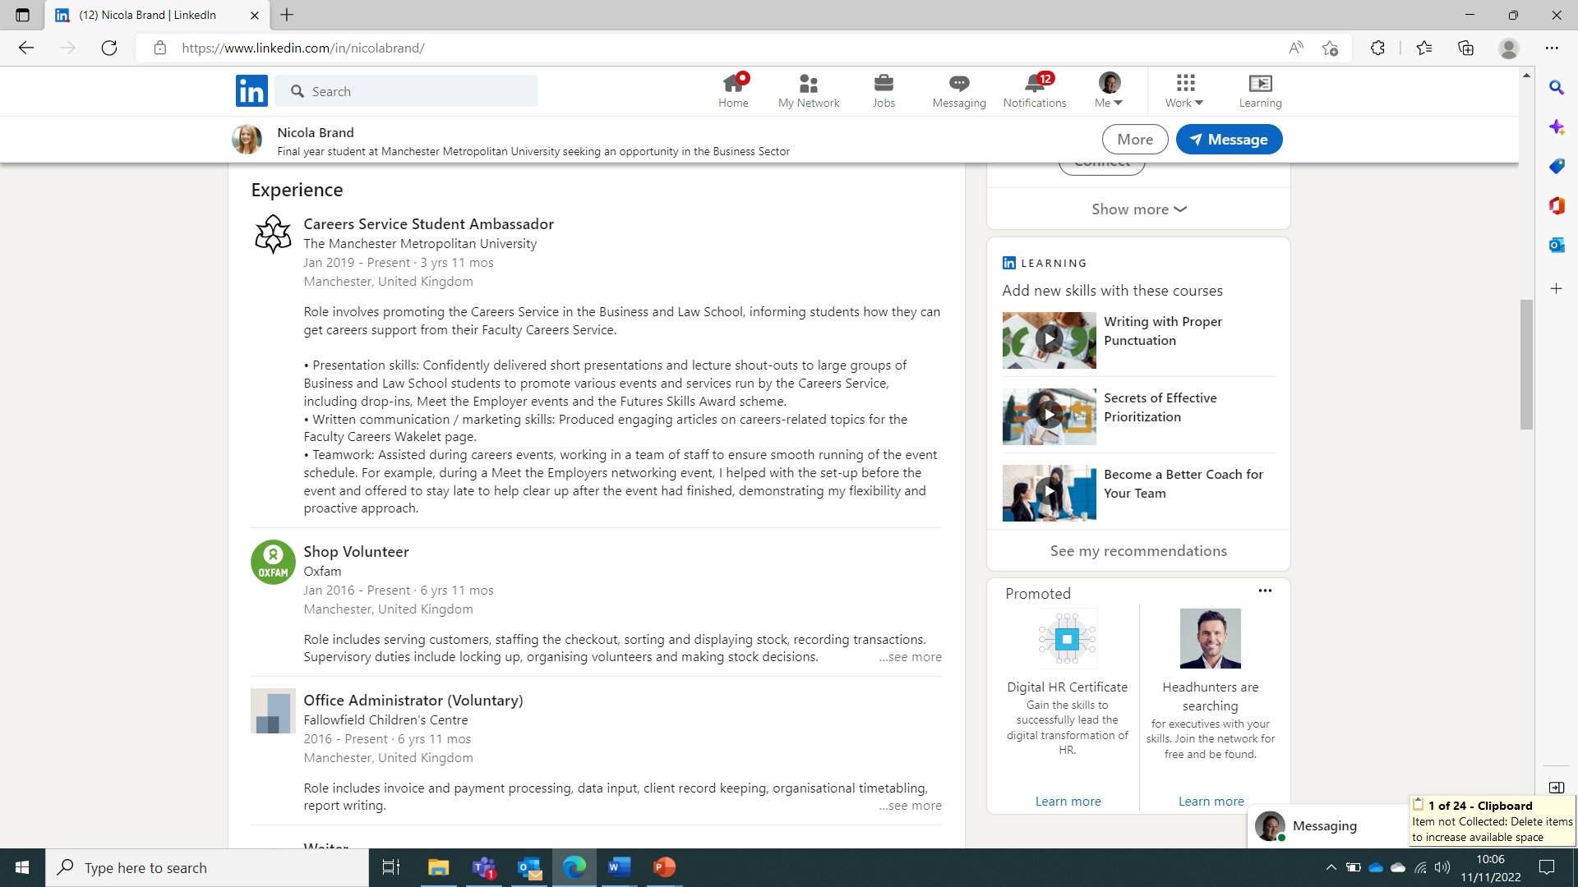
Add slide title here
Add text here

Slide 15
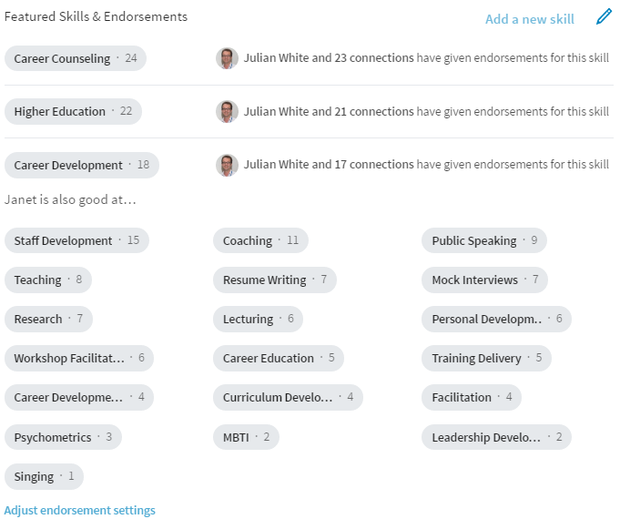
Skills- endorsements

Slide 16
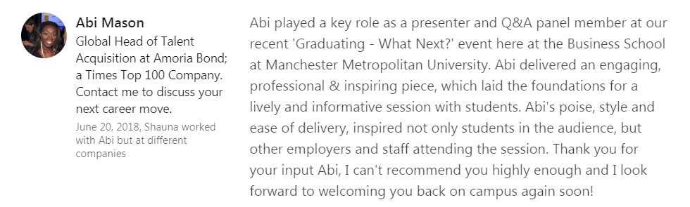
Recommendations

Slide 17

Let’s take a look at networking and engaging
How to make connections and engage via via Linked In
Visit mmu.ac.uk/careers

Slide 18
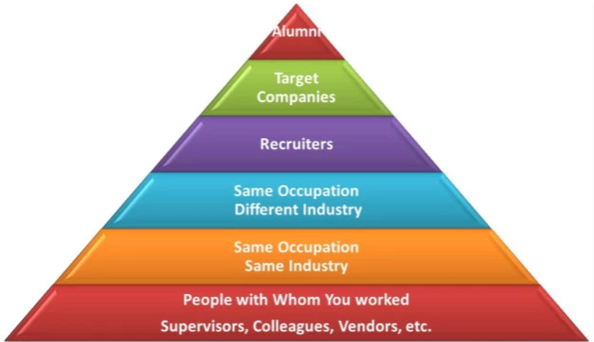


Who to network with

Slide 19
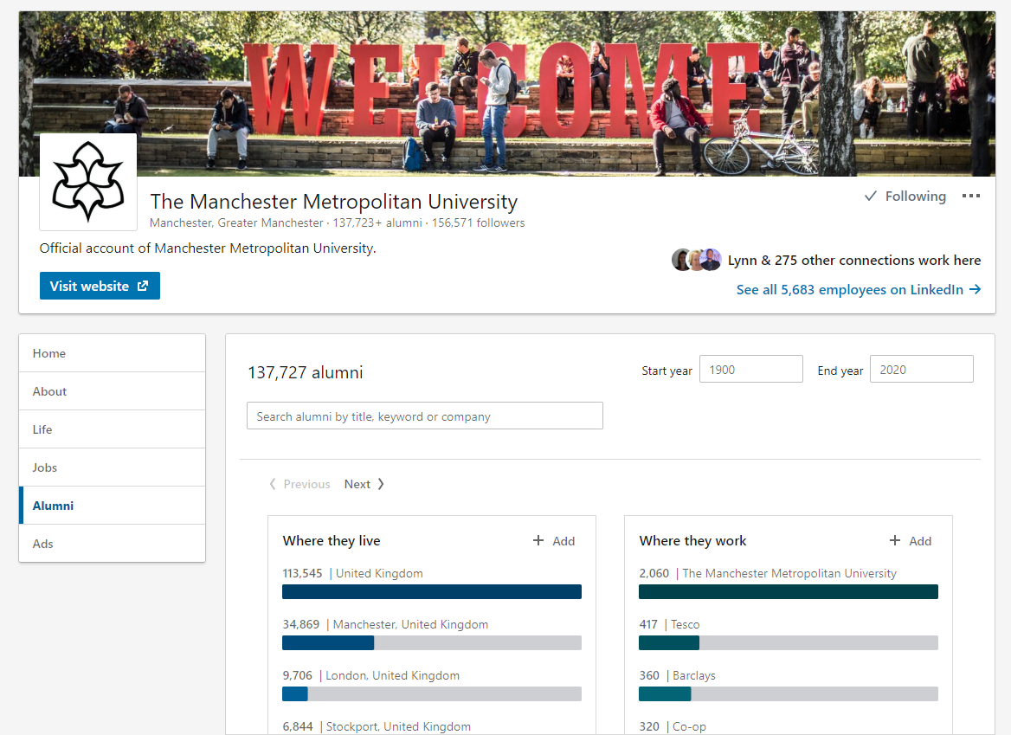
Linked In Alumni Tool

Slide 20
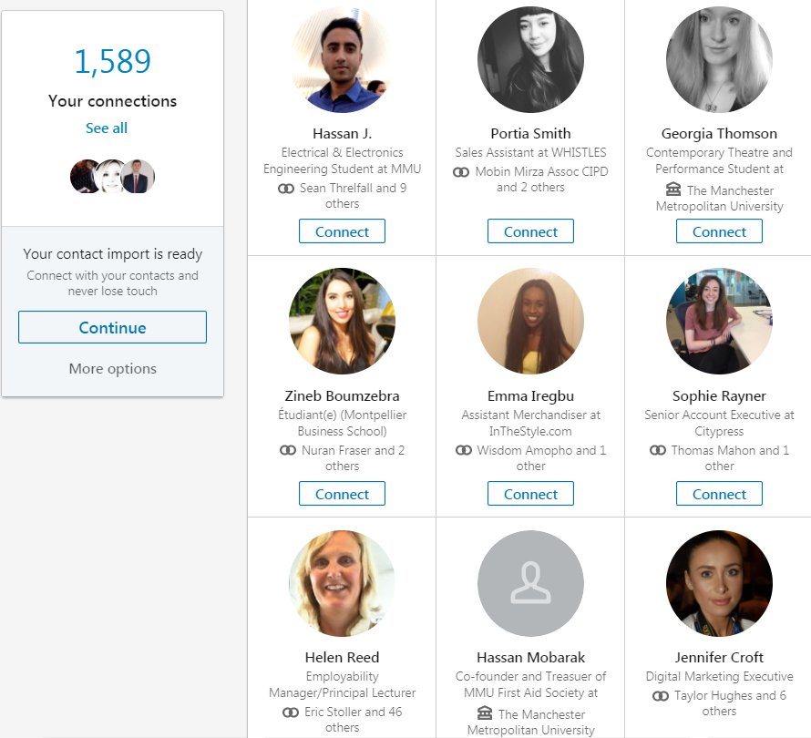
Build your network

Slide 21
Build your network
Send connection request to people you’re interested in networking with online:
Fellow work colleagues, past & present, managers and supervisors
Manchester Met alumni
Graduate recruitment/human resources/early careers staff
Professionals working in careers that interest you
Professionals working in work sectors, industries or professions that interest you
Write a concise, polite message, and ask something of interest!

Slide 22
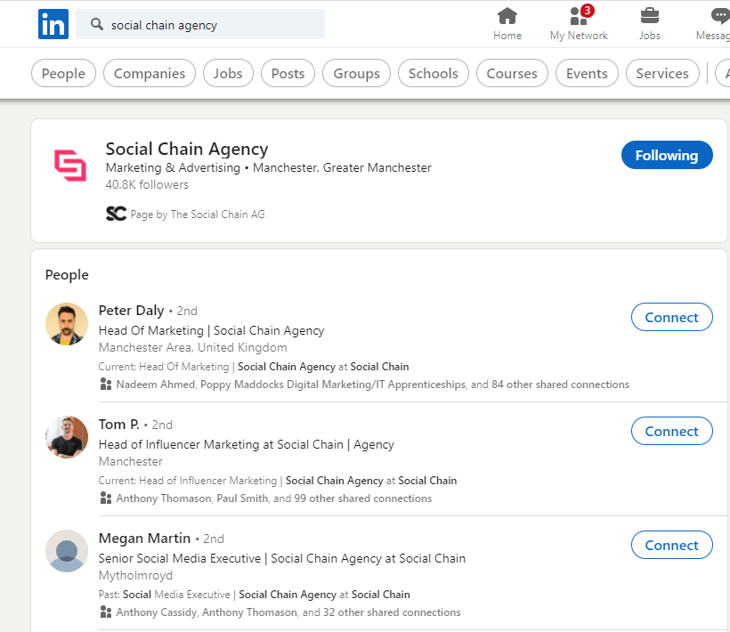

Follow companies & people

Slide 23
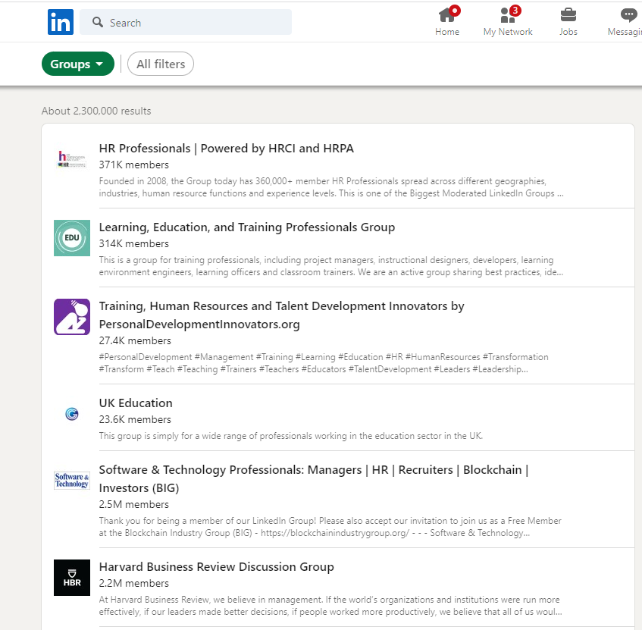

Join groups

Slide 24



Top tips!!
“Be active, share what you are doing to develop yourself as a person and professionally’
‘Connect with everybody you have worked with. Connections are gold and increases traffic to your page as people are more likely to engage with your content.”
Advice from graduates working at Join the Dots
Via Tim Griffiths, Learning & Development Manager

Slide 25
Top Tips!!
“Don’t be afraid to reach out to people working in the sector you're interested in via message, whether it’s for advice or to see if they have any opportunities...An opportunity can spring from a simple conversation, either way, it’s good to make connections.”
Sally Bracegirdle
Head of Student Engagement
Grad Touch

Slide 26
Useful resources and sites
Making the Most of Your Linked In Profile
Using Social Media for Job Hunting
LinkedIn Learning: LinkedIn for students
Managing Your Digital Footprint

Slide 27

Thank you For listening!
Any questions!!!

